Slide 1
Soaring to Success in the Fourth Grade Chocolate Factory
Ms. Bray & Mrs. N. Jackson
Fourth Grade Team
MonTe Sano Elementary
2024-2025
This Photo by Unknown Author is licensed under CC BY-SA

Slide 2
Meet Our Teachers
Language Arts & Social Studies:
Mrs. N. Jackson
Math & Science:
Ms. Bray

Slide 3
Monte Sano Elementary School Hours
School Hours are 7:00 am – 3:00 pm
Students may arrive at 7:00 am
Instruction begins at 7: 25 am and the Tardy bell rings at 7:30 am.
Dismissal process begins at 1:50 pm.

Slide 4
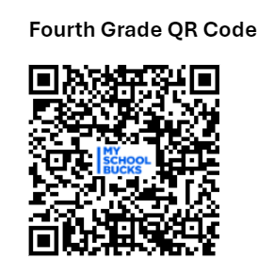
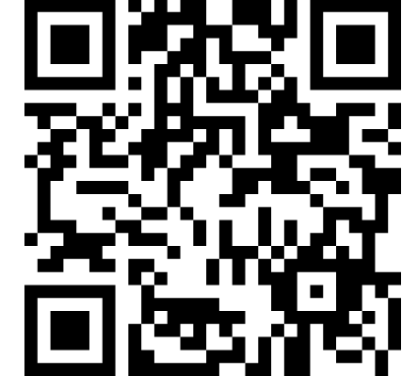
Class Dojo Codes
Ms. Bray
Mrs. Jackson

Slide 5
Homework Policy
Homework will be assigned for Monday- Thursday and due on Fridays.
Students who do not complete and turn in homework by Friday may be required to have a reflective recess on Fridays and they will work on the missed assignments.

Slide 6
Cell Phone Policy Reminder
Cell phones use is not permitted to the instructional school day.
Please refer the Richmond County School System’s Student Code of Conduct for specific details.

Slide 7
Rules/Expectations
What does respect mean?
Respect Yourself
Respect Others
Respect our Classrooms & School
(All Monte Sano Rules)
Golden Rule:
“Treat others (and their property) the way you want to be treated.”
Notes:
Ask students the following questions. Consider recording answers on chart paper and posting in the classroom: What does respect mean? If you respect something or someone, what are some thing you do? What are some things you don’t do?

Slide 8
Attendance/Tardy
Attendance is essential for students to do well and excel in school.
When you child is absent please provide an doctor’s note or written excuse upon the student’s return to school.
Please know that students miss valuable instruction when they are late or leave early. Please also know that 10 tardies equates to 1 absence.

Slide 9
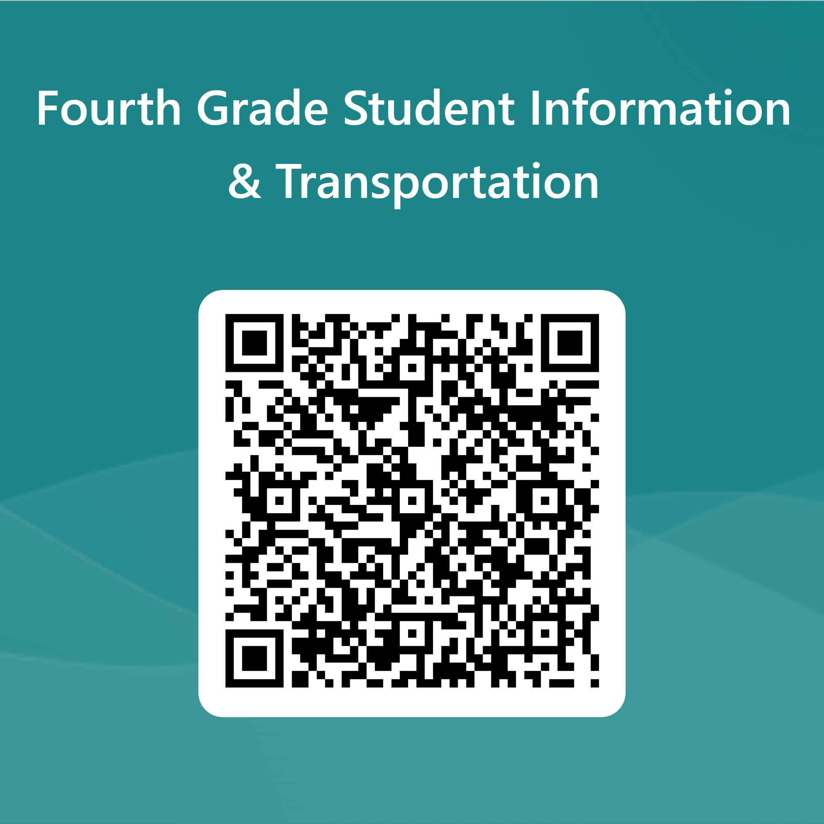
Transportation
To ensure that the fourth- grade team knows how your child will go home please take a brief moment to complete the form by scanning the QR Code below.
All changes to transportation should be communicated in writing. (We may see Dojo messages sent in the last 2 hours of the day. Please also notify the office if you need to make an immediate change at the end of the day).

Slide 10
Fourth Grade Consequences
1st Offence- Verbal Warning
2nd Offence- 10 min. Time Out
3rd Offence- Loss of Privilege with reflective writing assignment. The student will continue loosing privileges until the assignment is complete
4th Offence –Parent Contact

Slide 11
Our Responsibilities to YOU
To TEACH you
To ENCOURAGE you
To HELP you exceed your goals
To PREPARE you for your future careers and other endeavors
We are here for you!!!

Slide 12
Let’s make it an amazing school year!

